Slide 1
Factors Influencing Heart Disease Deaths
by Geographic Location, Ethnicity, and Gender

Slide 2
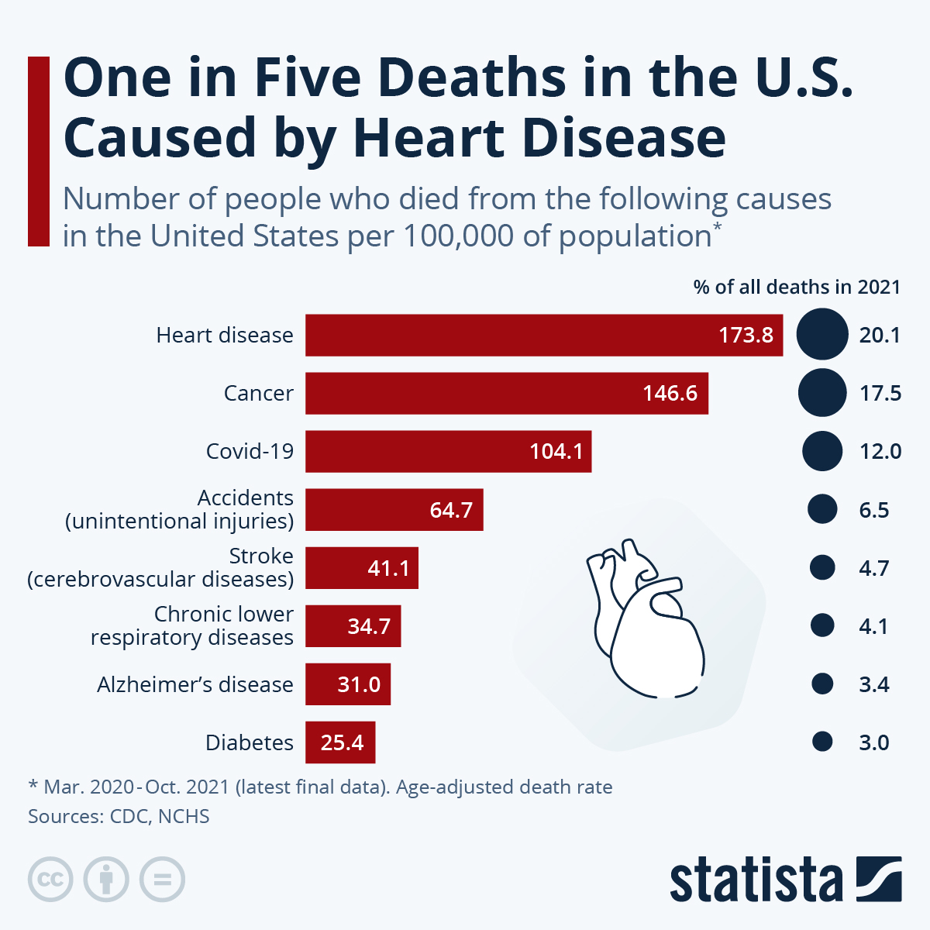
Understanding Heart Disease
# 1 death worldwide
Surpassing Cancer and Covid-19
2021 – 20% of all deaths in the U.S.
Cardiovascular diseases
Acute Myocardial infarction
Coronary Hear disease
Heart Failure
Strokes
(One in Five Deaths in the U.S. Caused by Heart Disease, 2024)
(Xu et al., 2022)
Notes:
Today, I want to shed light on a critical issue that affects millions of lives globally: heart disease.
As we delve into this topic, it's crucial to recognize its significance. Heart disease isn't just a health concern—it's a leading cause of death worldwide.
In the United States alone, the numbers are staggering. According to the Centers for Disease Control and Prevention (CDC), heart disease
has consistently claimed the top spot as the primary cause of death. Surpassing even cancer and COVID-19 in recent years,
heart disease remains a formidable adversary to public health.
What's even more concerning is the persistent rise in heart disease mortality rates. In 2021, it accounted for a shocking
20% of all deaths in the United States. Now, that's a statistic we can't afford to ignore.
But what exactly falls under the umbrella of heart disease? The CDC defines it broadly, encompassing major cardiovascular diseases such as acute myocardial infarction, coronary heart disease, heart failure, and strokes.
Image: https://www.statista.com/chart/30883/deaths-from-leading-causes-of-death-in-the-united-states/

Slide 3
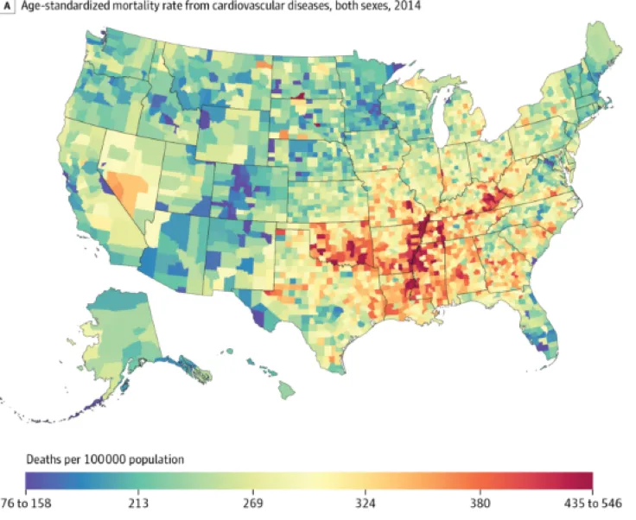
Understanding Heart Disease
35 years+ in the U.S. for 2014
Mortality rates per 100,000 people per county.
Gender, race, and location
Analyze individual-level data
Factors that influence heart disease
(Heart Disease Death Rates Vary Widely Across the US, Map Reveals, 2017)
(U.S. Department of Health & Human Services, 2023)
Notes:
Now, let's shift our focus to a specific dataset we've gathered. This dataset zooms in on heart disease mortality rates among individuals aged
35 and above in the United States for the year 2014. It provides mortality rates per 100,000 people for each county for individuals dealing
with heart disease. What's more, it includes variables such as gender, race, and geographical coordinates for each county.
Our aim with this study is clear: we want to understand the impact of gender, race, and geographical location on the likelihood of
developing heart disease. By analyzing individual-level data within the dataset, we hope to raise awareness of how these factors
can influence an individual's susceptibility to heart disease and ultimately, mortality outcomes.
In essence, this research isn't just about numbers—it's about people. It's about uncovering insights that can pave the way for
targeted interventions and ultimately save lives.
Image: https://www.acc.org//-/media/Non-Clinical/Images/Membership/Member-Benefits-and-Resources/Member-Publications/Cardiology/2018/10/Cover-1.jpg

Slide 4
- Geographical Location – County / State - Ethnicity/Race –White, Black, Hispanic, American Indian and Alaskan Native, and Asian and Pacific Islander - Gender – Male vs Female
Factors that Impact of Location, Ethnicity, and Gender
Notes:
We want to investigate why some people are more likely to die from heart disease than others. To do this, we'll look at three main factors:
Geographic Location: We'll examine whether heart disease death rates differ depending on where people live, focusing on counties within states.
Ethnicity/Race: We'll analyze how belonging to different ethnic or racial groups—such as White, Black, Hispanic, American Indian and Alaskan Native, and Asian and Pacific Islander—affects the likelihood of dying from heart disease.
Gender: We'll explore whether being male or female influences the risk of death from heart disease.
Understanding how these factors interact can help us identify patterns and develop strategies to reduce the risk of heart disease and improve overall health outcomes. Now, let's delve into our findings to see what insights we've uncovered!

Slide 5

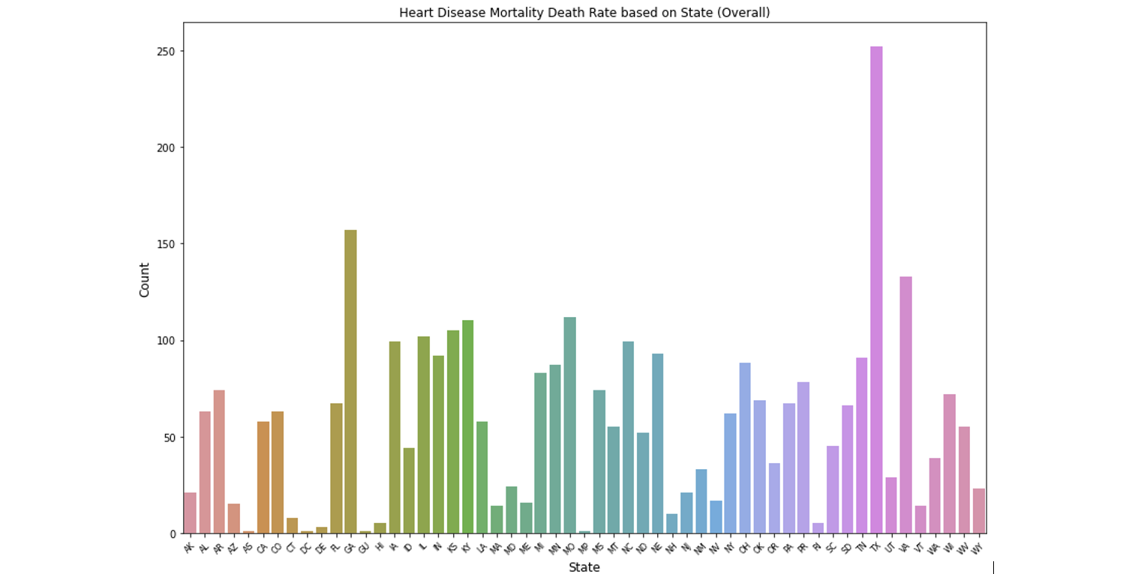
What are the influential factors of heart disease within the states?
Heart disease by states
Tall = more deaths
#1 Texas
#2 Georgia
Lowest = Hawaii & Delaware
Influential factors
Population
Healthcare
Income
Lifestyle
Resources
(Kreatsoulas & Anand, 2010)
Figure 1: Bar Plot of Heart Disease Mortality Death Rate on State (Overall)
Notes:
Let's look this bar chart showcasing the differences in heart disease death rates across the nation in the U.S.
This will help us grasp how heart disease varies state to state.
As we zoom into different states, we'll notice variations in these rates.
Each bar represents a state, and the height of the bar shows how many people have died from heart disease in that state.
The taller the bar, the more deaths there have been.
For instances Texas ranks number one with the highest heart disease deaths and coming in second is Georgia.
On the opposite end with the lowest heart disease deaths is Hawaii and Delaware.
We must determine which factors contributed to these extremes.
We need to determine if this information is based on the population, the quality of healthcare, how much they make, lifestyle choices, or resources available.

Slide 6
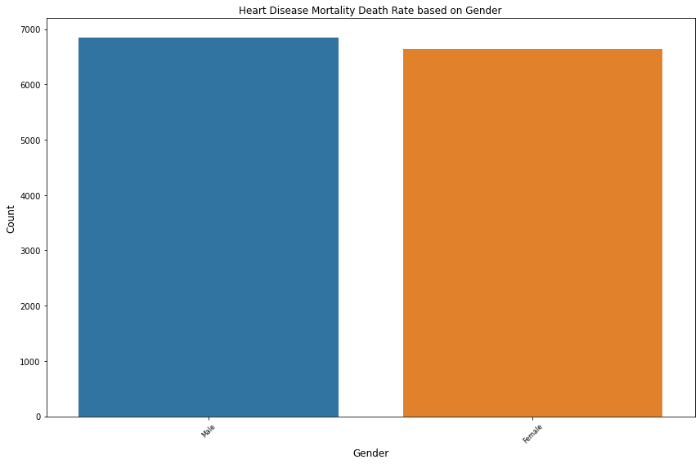
Heart Disease mortality between Males vs. Females
Males and Females about the same height
Heart disease is unbiased
Risk are different
Men
Lower estrogen
More alcohol
More stress
Less doctors visits
Women
Menopause
Less Estrogen
Autoimmune disease
High Depression & Anxiety
(Jhalani, 2022)
Figure 2: Bar Plot of Heart Disease Mortality Death Rate based on Gender
Notes:
We'll investigate the mortality rates due to heart disease and discuss the balance in representation between genders.
As we dive into this topic, it's crucial to understand that heart disease is a leading cause of death, but it doesn't affect all groups equally.
Look at this graph. You see two bars – blue representing males and orange representing females.
What's noteworthy here is the balance; the bars are almost the same height.
This means we have nearly an equal number of men and women in our data, giving us a clear, UNBIASED view of how heart disease impacts both genders.
Now, although our data seems well-balanced, it doesn't mean that the risks are the same.
Men and women can experience different symptoms, risk factors, and even outcomes when it comes to heart disease.
For males could it be hormonal factors?
Studies show that men who have lower levels of estrogen could be a factor.
Men are more likely to drink alcohol, they experience more stress, and less likely to visit the doctors.
For females, some factors may include menopause and a reduction of estrogen levels. Women are more susceptible to autoimmune disease and high rate of depression and anxiety which are contributing factors for an increase in heart disease.
Part of our ongoing research is to understand these differences better.

Slide 7
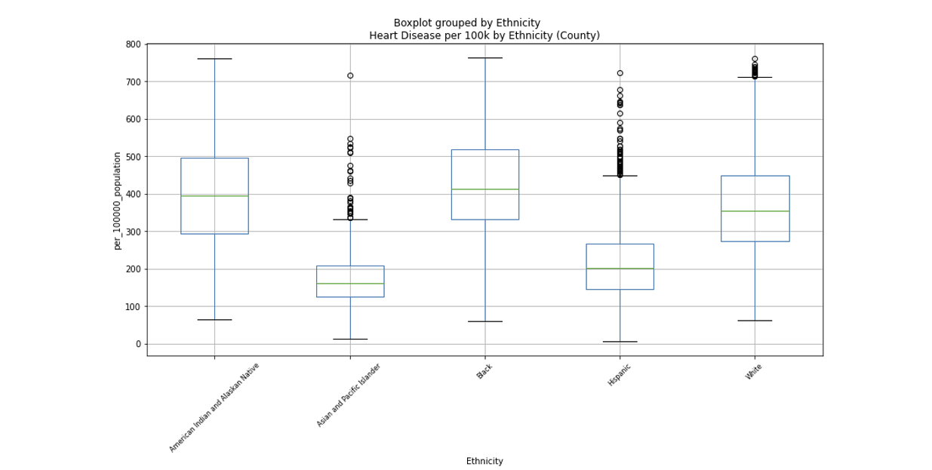
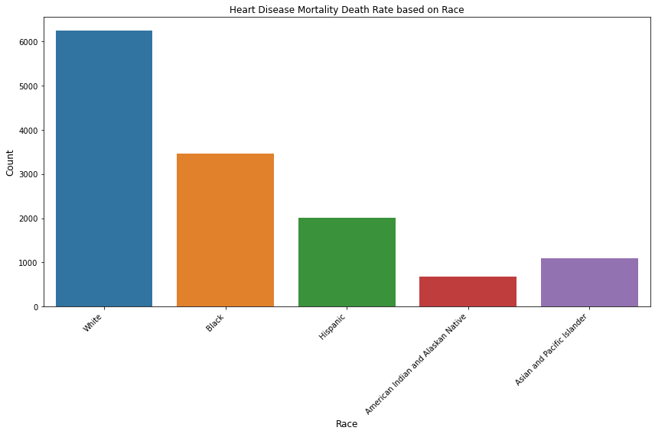
What are the impacts on Race/Ethnicity on Heart Disease?
Boxplot
Bar Graph
Figure 3: Box Plot of Heart Disease per 100k by Ethnicity based on County
Figure 4: Bar Plot of Heart Disease Mortality Death Rate based on Race
Notes:
Boxplot
In the chart to the left, we call it a boxplot, we're looking at boxes that represent the range of heart disease death rates for different ethnic groups.
The bottom line of each box shows us where the rates start to pick up, and the top line shows where they start to taper off. The line in the middle of the box?
That's the middle ground where most people fall—it's the average rate for that group.
Sometimes you'll see dots above or below the boxes. We call these outliers. These represent rates that are much higher or lower than most of the others—they're the exceptions to the rule.
Why are outliers important? They can tell us that there's more to the story.
For instance, a high outlier in the context of heart disease might prompt us to ask: Is there a reason why these few individuals had such high death rates?
This could be due to factors like access to healthcare, specific lifestyle choices, or even genetic predispositions.
On the other hand, understanding low outliers could lead to insights about what protective factors or behaviors might be contributing to significantly lower death rates in those cases.
Bar Graph
Now looking at the right, The tallest bar, which stands out the most, represents the ethnic group with the highest death rate from heart disease, while the shortest bar represents the group with the lowest rate.
This visual comparison makes it clear that heart disease does not impact all communities equally, and some groups may need more targeted health interventions and resources to reduce their risk.
The most noticeable bar, which is the tallest, represents individuals who identify as White. This indicates that within our dataset, White individuals have the highest recorded number of deaths due to heart disease.
On the other end of the spectrum, the shortest bar corresponds to those who identify as American Indian and Alaskan Native.
This method is a common practice in research to help identify disparities and potential factors contributing to differences in health outcomes across racial lines.

Slide 8
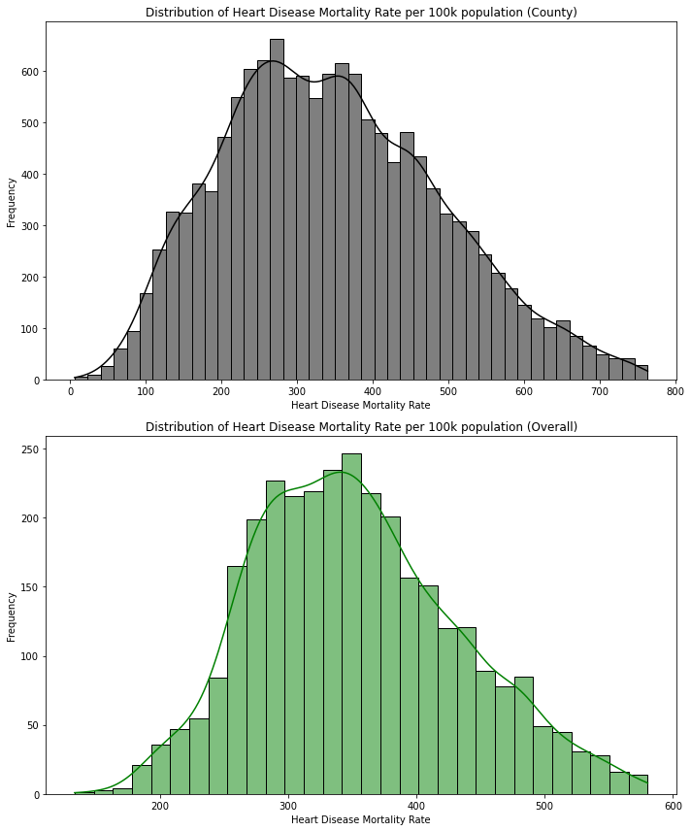
Histogram on Heart Disease Mortality Rate
Bell shape means what’s typical
Range of death per 100k people
How often it occurs
Higher = more deaths
Tallest = most common
Figure 5: Histogram Distribution of Heart Disease Mortality Rate per 100k population for County and Overall
Notes:
These are histograms representing the distribution of a health-related measurement across a population, with most values clustering around the middle.
The shape is bell-like, indicating a normal distribution, in other terms it helps us identify what's typical and what deviates from the norm.
It shows a range of deaths per 100,000 people and how often each range occurs.
The higher the bar means more death; the middle is where the bar is the tallest means it the most common.

Slide 9
Understanding how the Chi-square test affects heart disease death rates
Category | Chi-square statistic | p-value
Gender | 7.171499e+03 | 3.097805e-69
Ethnicity | 2.560000e+04 | 2.355235e-111
County | 9.512658e+06 | 1.000000e+00
State | 2.557907e+05 | 9.999865e-01
Chi-square statistics – Observed data that deviates from chance.
Larger = what we see vs what would occur randomly
P-Value = Difference due to chance
Small p-value less than 5% = real significant difference
Differences
Gender & ethnicity = p-values are tiny, strong link to heart disease death rate
County & state = p-values close to 1 show no connections to heart rate death rates.
Figure 6: Chi-Square for heart disease based on Gender, County, State
Notes:
Now, this next slide may look a little confusing. You may be wondering what all these numbers mean.
This table is a summary of a statistical test called "Chi-square," which helps us determine if there are significant association in heart disease mortality rates across different categories like gender, ethnicity, county, and state.
Chi-square statistic: This number measures how much the observed data deviates from what we would expect by chance alone.
Larger numbers mean greater differences between what we see and what would occur randomly.
p-value: This tells us whether the data is happening due to association or chance. A small p-value (typically less than 5% or 0.05) suggests that the differences
are association and not just random.
Here's what the numbers are telling us:
There is a strong link between gender and ethnicity and heart disease mortality rates. We know this because the chi-square statistic numbers were huge,
and the p-values were tiny – almost zero.
2. On the other hand, when we look at county and state, it's a different story. The p-values were 1 or very close to 1. tells us that any differences we see in
mortality rates across counties and states might just be due to random chance – there's no significant connection.

Slide 10
What is a Z-test and how does it affect heart disease death rate?
Z-test compares 2 groups
Gender
Females have lower heart disease deaths
(z-score -56, p-value <0.05)
Ethnicity
Hispanic & Asian and Pacific Islander have lower mortality rates
(z-score -58 Hispanic & -81 Asian and Pacific Islander, both p-values < .05)
Location
County - No significance
State – Significant Impact > Arizona, California, Colorado
Notes:
To double check our numbers we performed a Z-test.
It is a method that tells us the difference between two groups, such as men and women or black and whites to determine if it’s a true difference.
If it's negative, it means the number we're looking at is lower than the average. A small p-value, >0.05, means we should sit up and take notice; it's less likely to be a fluke.
1.Our studies show that women tend to have lower heart disease mortality rates compared to men.
This is not a small difference - the numbers strongly suggest that being female is linked to a lower risk of dying from heart disease.
2. When it comes to ethnicity, we see that not all groups are affected equally.
Specifically, Hispanic and Asian and Pacific Islander populations are showing significantly lower mortality rates.
3. And about where we live? It turns out, the impact of living in different counties doesn't show a clear pattern in heart disease mortality rates.
However, when we zoom out to look at the state level, certain states like Arizona, California, and many others show significant number.

Slide 11
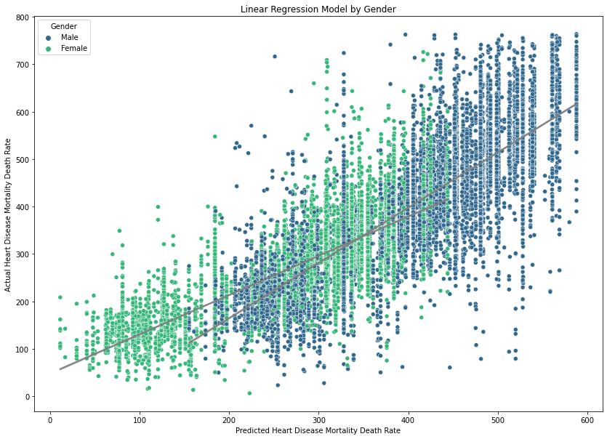
Linear Regression Model displays heart mortality between Males vs Females.
Females' death rate is lower in the age bracket tested
Men have a higher risk of death
Significant difference
Females = 297 per 100k
Males = 437 per 100k
Figure 7: Linear Regression Model by Gender
Notes:
Female trend line in the light green, has a gentler slope than male. When we look at this pattern, we see that the line for women increases more slowly,
suggesting that the number of heart disease deaths for women rises less sharply with age.
Men, in the blue, have a steeper increase in heart disease deaths with age. Unfortunately, for men, as they get older, the risk of dying from
heart disease climbs at a faster rate.
Significant difference in mortality rates between genders. Our analysis shows that this isn't just random; there's a clear and
meaningful difference in how heart disease is affecting men and women.
There were 297 women out of 100,000 people and Males had a 140 increase from the women.

Slide 12
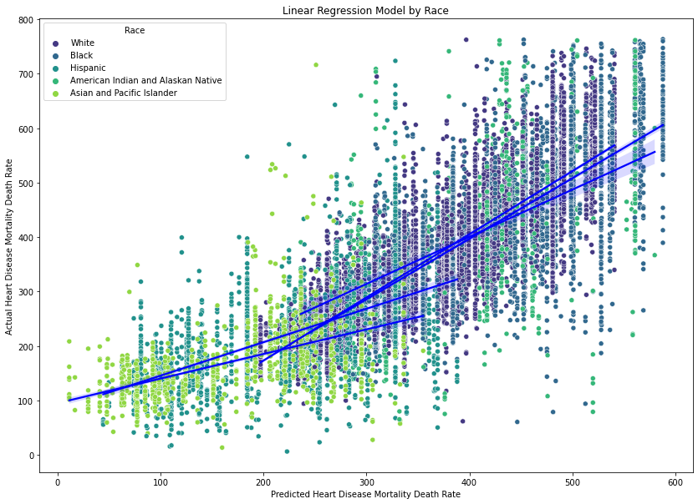
Linear Regression Model displays heart mortality by Race
Whites 368 people out of 100,000 population
Black increases by 60 people
American Indian and Alaskan Natives increases by 35 people compared to Whites
Hispanics have 151 fewer deaths
Asian and Pacific Islanders have 195 fewer deaths
Figure 8: Linear Regression Model by Race
Notes:
This Model gives us a clear picture on which race is most or least affected by the death of heart disease.
- White used as baseline of 368 out of every 100,000 being affected by heart disease
Now, when we look at the Black and American Indian and Alaskan Native communities, we see an increase in heart disease deaths.
For Black individuals, the rate goes up by 60, and for American Indian and Alaskan Native, it goes up by 35 compared to the White group.
However, it's a different story for the Hispanic and Asian and Pacific Islander groups. They see a decrease.
Hispanics have 151 fewer deaths, and Asian and Pacific Islanders have 195 fewer deaths than the White group per 100,000 population.
To note clustering models shows very similar results

Slide 13
Heart Disease Mortality Rates Results & Recommendations
Diverse Impact between race and gender
Investigate next steps
Geographical Factors
Research more in ethnicities and their environments affected globally
Create a public health strategy for higher risk individuals or groups
Notes:
Diverse Impacts: We see that gender and ethnicity have significant roles in heart disease mortality rates. Women, Asian and Pacific Islanders, and
Hispanics generally show lower rates, whereas Black males are most affected.
Investigative Next Steps: To tackle these disparities, we need to dig deeper. Understanding cultural and lifestyle influences, like diet and societal
norms, is crucial for developing targeted interventions.
Geographical Factors: Our study hints at certain states having a unique influence, though it's a small part of the overall picture.
We're curious about how broader environmental factors, like climate, or environment factors might play a role
Future Research Direction: Moving forward, we aim to explore how different ethnicities worldwide are affected by their environments.
This global perspective could unveil new strategies to fight heart disease, especially in those critical middle years of life.
Public Health Strategies: Armed with this knowledge, public health initiatives can be more customized and effective, reaching those at higher risk with precision and care. Also to continue to raise awareness of how impactful heart disease is
In essence, our study is to understand these patterns, so we can save lives and improve the heart health of people everywhere.

Slide 14
Contributions
Aaron Ramirez
Outhai Xayavongsa
Created the GitHub
Cleaned and created 2 data sets
Removed the outliers
Got the 5 number summary for both datasets
Got the error rate for the datasets
Created the histogram for both data sets
Qc the boxplots and bar graphs
Created the ‘overall’ boxplots and bar graphs
Qc the chi square
Qc the z-score
Created linear regression for gender
Created linear regression for ethnicity
Identified multicollinearity and Created vif process for fix
Identified multicollinearity and Created vif process for fix
Created the hot encoded process for multi categorical variables
Created linear regression for states
Pulled out the states of interest
Created clustering models and process
QC linear regression modeling
Pulled out the linear regression models to identify the anomalies for states
Wrote the technical report
Found references for the introduction statistics for the report
QC the presentation
Researched Datasets
Initiated & Scheduled Meetups
Cleaned data set
Completed the Team Project Status Update Form
QC the Technical Report
Added to and reformatted the Intro, Conclusion
Added References in APA to the Tech Report
PowerPoint Citations
Completed the full APA format for the Tech Report
Created the PowerPoints
Wrote the Scripts for the PowerPoint
Completed the Exploratory Data Analysis and Model Analysis
Bar plots for all except ‘Overall’
Chi-Square
Z-test for all
Linear Regression Models for Gender & Location
Box Plots
Reviewed Aarons added visuals:
Cluster model
Linear Regression for the states
Linear regression for ethnicity
‘Overall’ Box Plot
Submit all deliverables
Presentation on 1st half of the PowerPoints

Slide 15
References
Delzo, J. (2017). Heart Disease Death Rates Vary Widely Across the US, Map Reveals [Photograph]. Medical Daily. https://www.medicaldaily.com/cardiovascular-disease-ischemic-heart-disease-cerebrovascular-disease-stroke-417509
Jhalani, N., MD (2022, February 28). Heart Disease in Women is Not Like Heart Disease in Men. Columbia University Irving Medical Center. Retrieved February 24, 2024, from https://www.columbiadoctors.org/news/heart-disease-women-not-heart-disease-men#:~:text=Commonly%20known%20as%20heart%20disease%2C%20cardiovascular%20disease,for%20people%20with%20autoimmune%20diseases%20and%20pregnancy%2D
Kreatsoulas, C., MSc, & Anand, S. S., MD PhD (2010). The impact of social determinants on cardiovascular disease. National Library of Medicine, 26(Suppl C), 8C-13C. https://doi.org/10.1016/s0828-282x(10)71075-8
U.S. Department of Health & Human Services (2023, August 26). Heart Disease Mortality Data Among US Adults (35+) by State/Territory and County. Data.gov. Retrieved January 27, 2024, from https://catalog.data.gov/dataset/heart-disease-mortality-data-among-us-adults-35-by-state-territory-and-countyhttps://catalog.data.gov/dataset/heart-disease-mortality-data-among-us-adults-35-by-state-territory-and-county
Xu, J., Murphy, S. L., Kochanek, K. D., & Arias, E. (2022, December 22). Mortality in the United States, 2021. Center for Disease Control and Prevention. Retrieved February 24, 2024, from https://stacks.cdc.gov/view/cdc/122516
Zandt, F. (2024). One in Five Deaths in the U.S. Caused by Heart Disease [Photograph]. Statista. https://www.statista.com/chart/30883/deaths-from-leading-causes-of-death-in-the-united-states/

